Slide 1

Karel Assignment
Atypon Training Program 2023
By Yussif Abdalla

Slide 2
Presentation Outline
Problem Definition
Introduction
Solution Methodology
Novel Advance Commands
Solution approach Flowchart
Karel Code Demonstration
Detailed Solution Steps
Conclusions
References

Slide 3
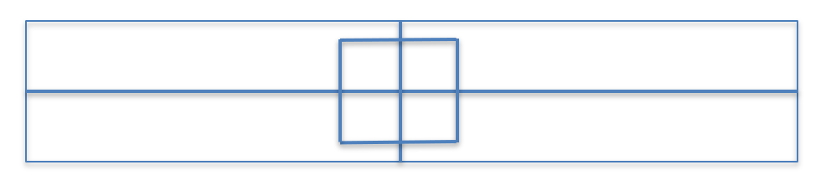
Problem Definition
Use Karel the Robot to draw a given map into 4 + 4, where the following constraints must be observed:
The inner chambers should be the biggest possible equal squares
The outer chambers should be equal in size, and they should be L-shaped
Optimized number of double lines of beepers may be used
Karel should achieve his task with the lowest number of moves

Slide 4
Introduction
To help in programing, In 1970 a Rich Pattis Stanford graduate student named perceived an idea that would help novice programmers to think like professional programmers in solving problems.
Rich designed an introductory programming environment in which students teach a Robot to solve simple problems, hence they will learn the logical sequencies in problem solving

Slide 5
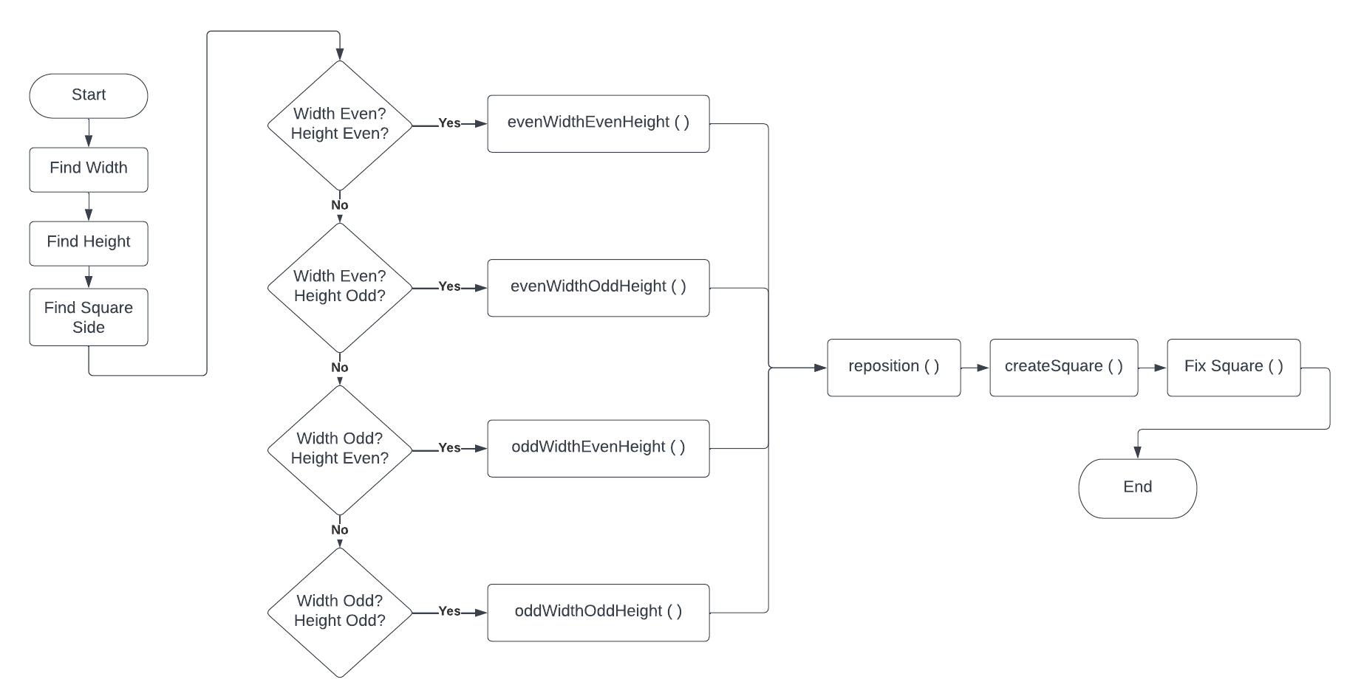
Solution Approach Flowchart

Slide 6
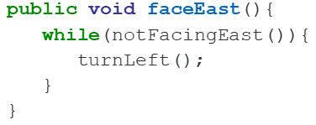
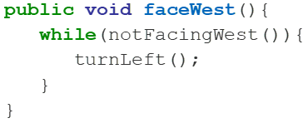
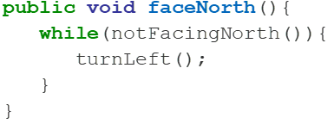
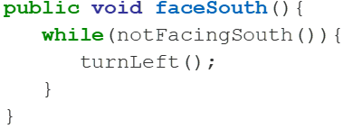
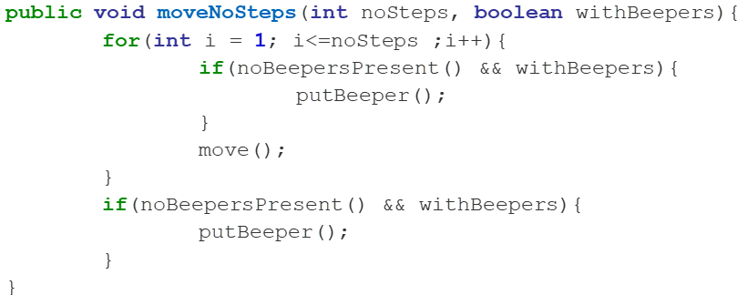
Novel Advance Commands
I propose using the following new reusable functions
Robot Heading and Orientation Commands
faceNorth()
faceEast()
faceSouth()
faceWest()
Robot Continuous Marching
moveNoSteps(int noSteps, boolean withBeepers)
moveTillEnd(boolean withBeepers)
Lowest possible number of lines achieved by new reusable functions

Slide 7
Optimization Strategies
Optimizing Map Identification
Optimizing Karel Steps
Optimizing Karel Possible Execution Scenarios
Optimizing Karel Beepers
Optimizing Karel reusable functions

Slide 8
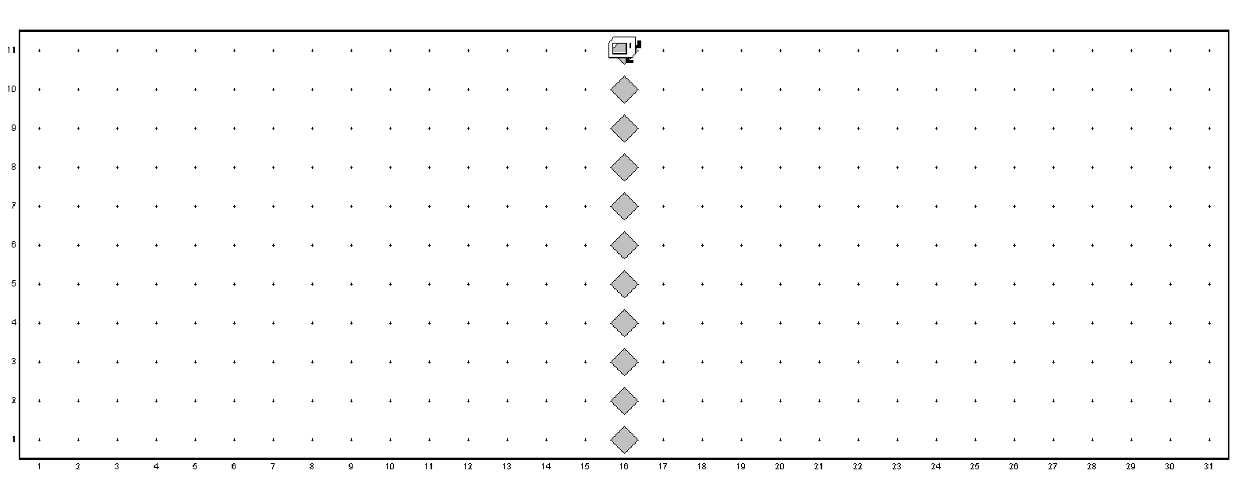
Optimizing Map Identification
To help Karel to identify the width and the height of the map
Karel first identify the width by marching, then heads for the center
Karel will place beeps while identifying the height

Slide 9
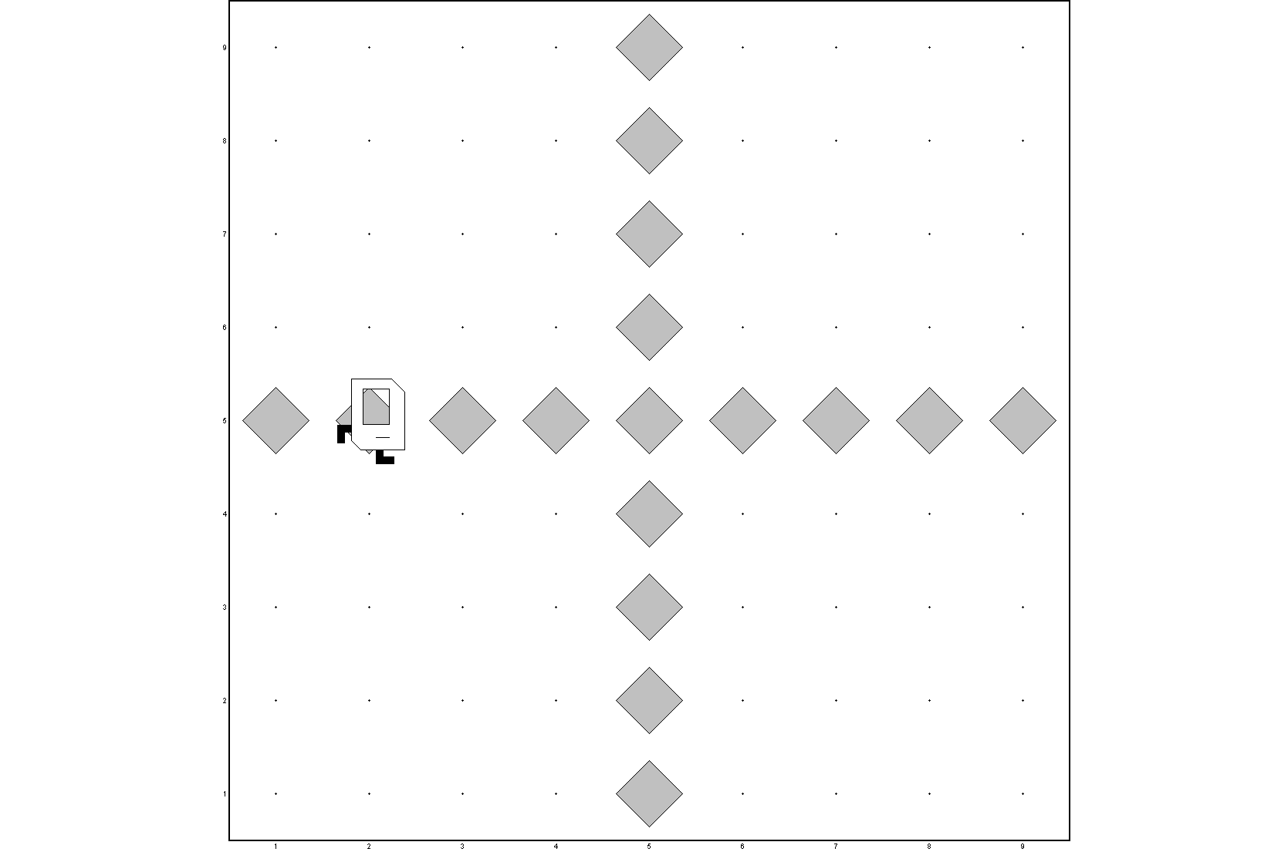
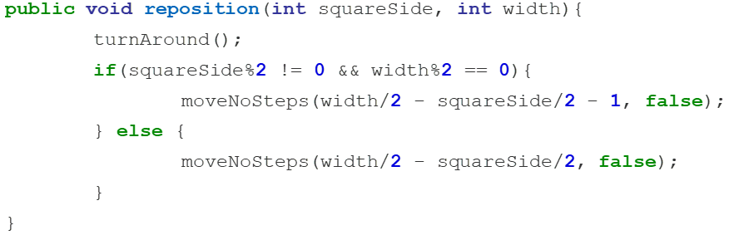
Optimizing Karel Steps
Optimal position for placing Karel would be at one of the corners along the perimeter of the square and not from the center.
Before making a square Karel turns around and moves (width/2 - squareSide/2) steps without beepers
This places Karel on the perimeter of the square

Slide 10
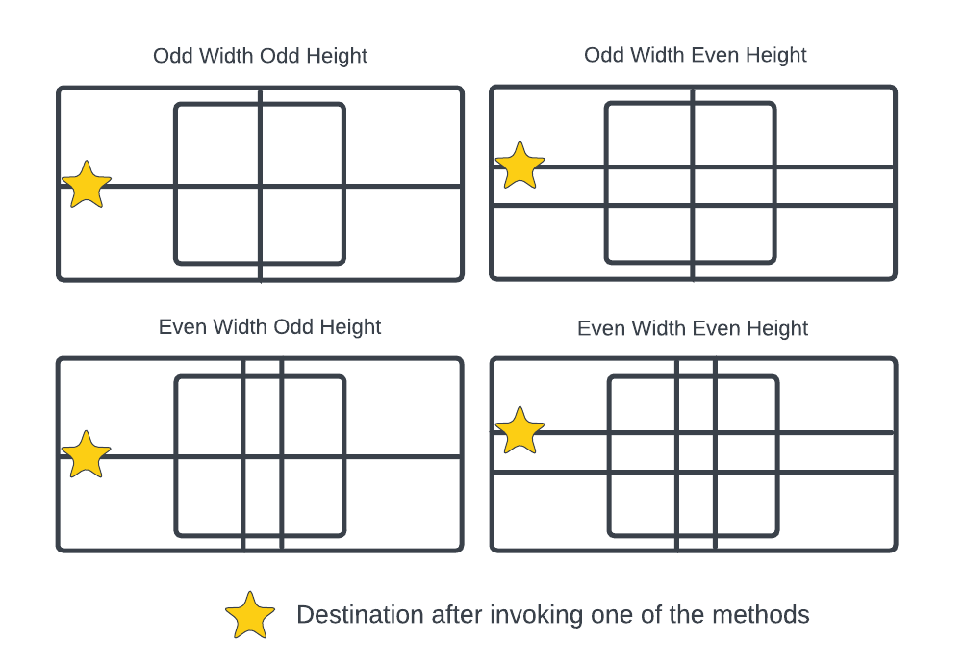
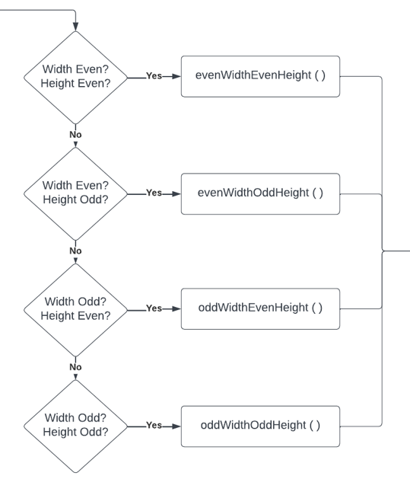
Karel Possible Execution Scenarios
After invoking one of the four functions, is to have the horizontal line drawn and no matter what scenario Karel has encountered he should land on the same the corner shown in the image.

Slide 11
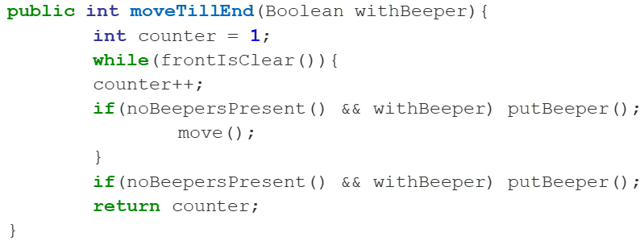
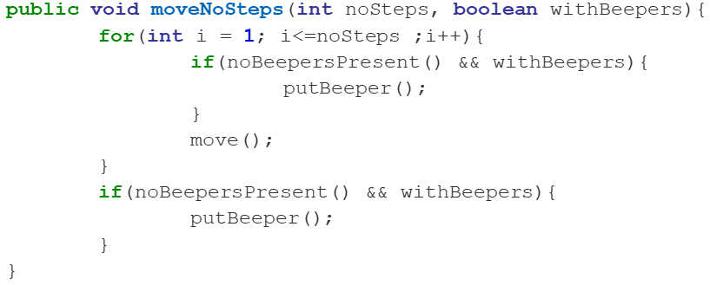
Optimizing Karel Beepers
Placed beepers should be optimized
by ensuring that no beepers are present before dropping a new one
to guarantee that Karel only has one beeper per corner, preventing any overlapping or unnecessary additional beepers in the solution

Slide 12
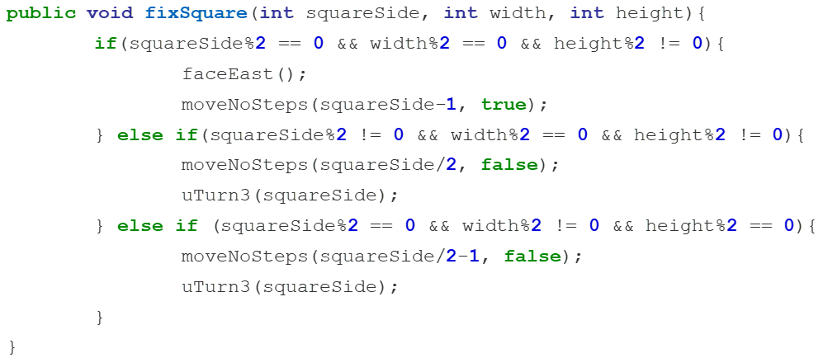
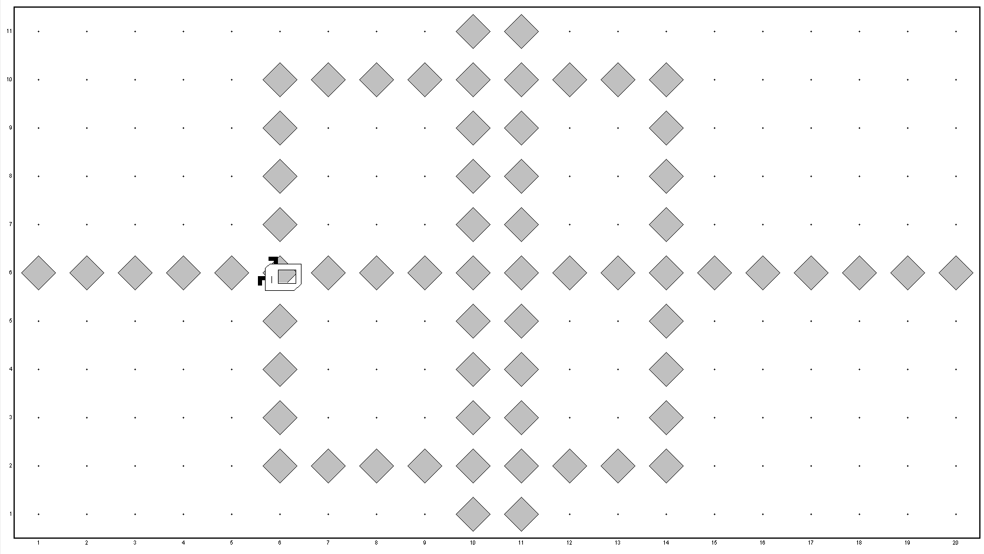
Fixing the Square
In exceptional cases the inner chamber sizes will not match, hence a fixSquare method is added to resolve the issue without Karel movement
The approach depends on examining the square side width and height
This will optimize the solution and requires fewer steps for Karel to make

Slide 13
Conclusions
Diversity of Map scenarios were successfully executed
Minimum number of Karel moves achieved
Exceptional maps are identified and handled
Lowest possible number of lines achieved by new reusable functions
Solution is accomplished with minimum number of placed beepers
Complete report was written
Work solution is presented

Slide 14
References
Eric Roberts, Karel the Robot – Learn Java, Stanford University, September 2005
Dr Motasem Diab, Karel Assignment, Atypon Training Program 2023.

Slide 15
Thank You

